Slide 1
Data Mining
Ch 10: Cluster Analysis - 3
Grid-Based Methods
Evaluation of Clustering
Wan D. Bae, Ph.D.
baewd@hanyang.ac.kr

Slide 2
Overview
Cluster Analysis Basic Concepts
Type of data in clustering analysis
Major Clustering Methods
  Partitioning Methods
  Density-Based Methods
  Hierarchical Methods
  Grid-Based Methods
Evaluation of Clustering

Slide 3

Assessing Cluster Tendency
Spatial randomness by statistic test using Hopkins statistic
  Given a dataset D regarded as a sample of a random variable o, determine how far away o is from being uniformly distributed in the data space
  Sample n points, p₁, …, p_{n}, uniformly from D. For each p_{i}, find its nearest neighbor in D:
  x_{i} = min{dist (p_{i}, v)}, where v in D
  Sample n points, q₁, …, q_{n}, uniformly from D. For each q_{i}, find its nearest neighbor in D – {q_{i}}:
  y_{i} = min{dist (q_{i}, v)} where v in D and v ≠ q_{i}
  Calculate the Hopkins Statistic:
  If D is uniformly distributed, ∑ x_{i} and ∑ y_{i} will be close to each other and H is close to 0.5. If D is highly skewed, H is close to 0

Slide 4
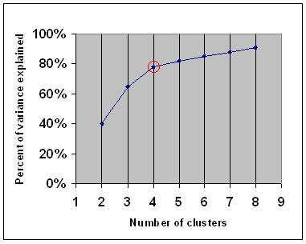
Determine the Number of Clusters
Empirical method
  # of clusters ≈ √n/2 for a dataset of n points
Elbow method
  Use the turning point in the curve of sum of within cluster variance w.r.t the # of clusters
    Example: the "elbow" is indicated by the red circle. The number of clusters chosen should therefore be 4.

Slide 5
Determine the Number of Clusters cont.
Cross validation method
  Divide a given data set into m parts
  Use m – 1 parts to obtain a clustering model
  Use the remaining part to test the quality of the clustering
    e.g., For each point in the test set, find the closest centroid, and use the sum of squared distance between all points in the test set and the closest centroids to measure how well the model fits the test set
  For any k > 0, repeat it m times, compare the overall quality measure w.r.t. different k’s, and find # of clusters that fits the data the best

Slide 6
Measuring Clustering Quality: Extrinsic
Supervised: Compare a clustering against the ground truth using certain clustering quality measure
Clustering quality measure
  Q (C, C_{g}), for a clustering C given the ground truth C_{g}
  Q is good if it satisfies the following 4 essential criteria
    Cluster homogeneity: the purer, the better
    Cluster completeness: should assign objects belong to the same category in the ground truth to the same cluster
    Rag bag: putting a heterogeneous object into a pure cluster should be penalized more than putting it into a rag bag (i.e., “miscellaneous” or “other” category)
    Small cluster preservation: splitting a small category into pieces is more harmful than splitting a large category into pieces
  Example: BCubed precision

Slide 7
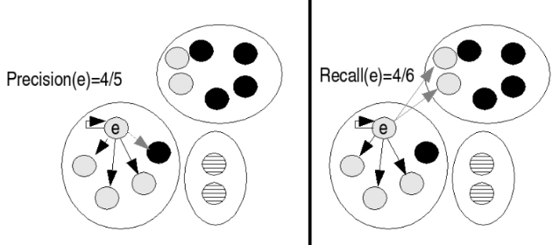
Measuring Clustering Quality: Extrinsic
  BCubed precision
    The proportion of items in its cluster which have the item’s category (including itself)
    The averaged precision of all items in the distribution. Since the average is calculated over items, it is not necessary to apply any weighting according to the size of clusters or categories

Slide 8
Measuring Clustering Quality: Intrinsic
Unsupervised
  Evaluate the goodness of a clustering by considering how well the clusters are separated, and how compact the clusters are
Example: Silhouette coefficient method
  The silhouette value is a measure of how similar an object is to its own cluster (cohesion) compared to other clusters (separation)
    The silhouette values can be calculated with any distance metric, such as the Euclidean distance.
  The silhouette ranges from -1 to 1, where high value indicates that the object is well matched to its own cluster and poorly matched to neighboring clusters.
    If most objects have a high value, then the clustering configuration is appropriate.
    If many points have a low or negative value, then the clustering configuration may have too many or too few clusters.

Slide 9


Measuring Clustering Quality: Intrinsic
Silhouette coefficient method
  For each datum i, let a(i) be the average dissimilarity of i with all other data within the same cluster
    a(i) shows how well i is assigned to its cluster
    the smaller the value, the better the assignment
  We then define the average dissimilarity of point i to a cluster c as the average of the distance from i to all points in c.
  Let b(i) be the lowest average dissimilarity of i to any other cluster, of which i is not a member.
    The cluster with this lowest average dissimilarity is said to be the "neighboring cluster" of i because it is the next best fit cluster for point i
  A silhouette s(i) is defined as:

